Slide 1


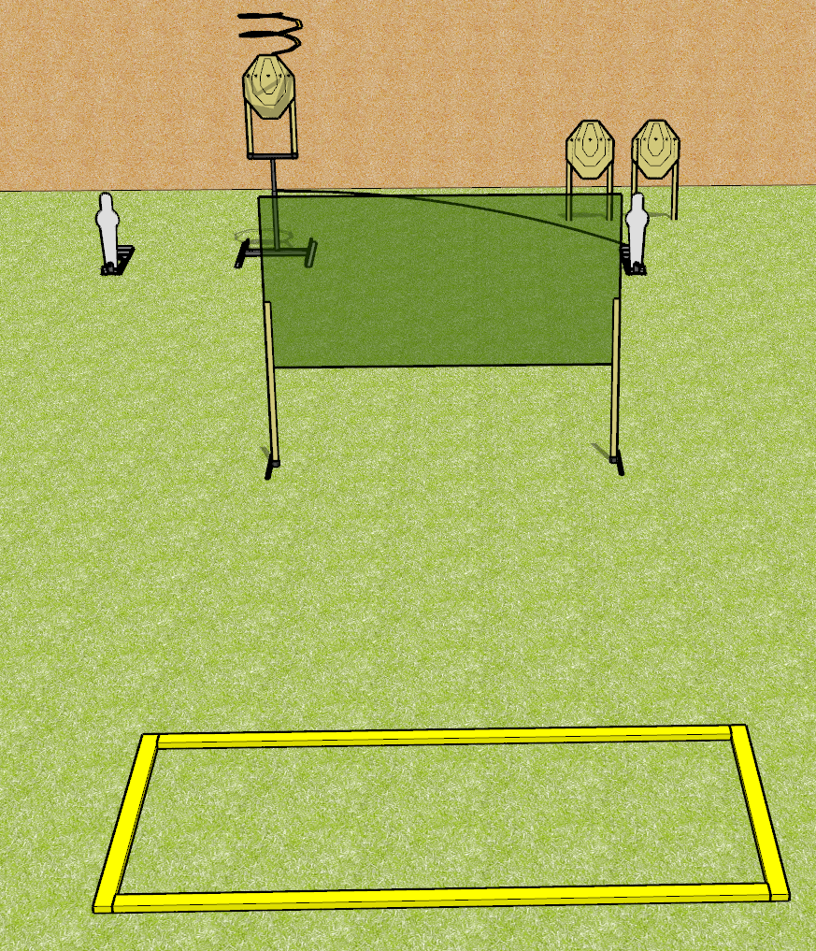
 | Dothan Gun Club – USPSA Match Short Stuff Course Designer : Drew Coleman
Round Count 8 rounds 3 IPSC 2 mini poppers
Equipment List 2 wall feet Drop turner 2 medium fault lines

Slide 2
Short Stuff
Written Stage Briefing
Short Stuff is an 8 round, 40 point, Comstock course of fire. There are 3 IPSC targets and 2 mini poppers. The best 2 hits on paper will score, and steel must fall to score. The start signal is audible.
The drop turner is activated by the right mini popper, and is a disappearing targets. Please check the activator prior to walkthrough and set it the same way every time.
Handgun start position is toes touching rear fault line, facing uprange, wrists above shoulders. Handgun is loaded and holstered.
PCC start position is heels touching rear fault line, stock on belt. Loaded carbine is held with both hands, safety on.
On start signal, engage targets as they become available from within the shooting area.

